Slide 1
Amit Kumar Das
Prolog: LAB 1
Lecturer,
Department of Computer Science & Engineering,
East West University
Dhaka, Bangladesh.

Slide 2
Prolog:
Programming in Logic
with some mention of Datalog and Constraint Logic Programming

Slide 3
The original declarative programming language
Courses in programming languages …
  Prolog is always the declarative language they teach.
  (imperative, functional, object-oriented, declarative)
Alain Colmeraeur & Philippe Roussel, 1971-1973
  With help from theorem proving folks such as Robert Kowalski
  Original project: Type in French statements & questions
    Computer needed NLP and deductive reasoning
  Efficiency by David Warren, 1977 (compiler, virtual machine)
  Colmerauer & Roussel wrote 20 years later:
  “Prolog is so simple that one has the sense that sooner or later someone had to discover it … that period of our lives remains one of the happiest in our memories.
  “We have had the pleasure of recalling it for this paper over almonds accompanied by a dry martini.”

Slide 4
Prolog vs. ECLiPSe
Most common free Prolog implementation is SWI Prolog.
  Very nice, though faster ones are for sale (e.g., SICSTUS Prolog).
To run Prolog, you can just run ECLiPSe!
  ECLiPSe is a perfectly good Prolog implementation,
  although so far we’ve concentrated only on its “extra” features.

Slide 5
Prolog vs. ECLiPSe
Constraint programming | Logic programming (e.g., Prolog) | Constraint logic programming (e.g., ECLiPSe)
Efficient: Variable ordering Value ordering Constraint joining and propagation But: Encoding is annoying Variables limited to finite sets, ints, reals | Expressive: Subroutines Recursion Variable domains are “terms” (including lists and trees) But: Simple, standard solver: backtracking and unification | Combo: Tries to combine best of both worlds Later on we’ll see how

Slide 6
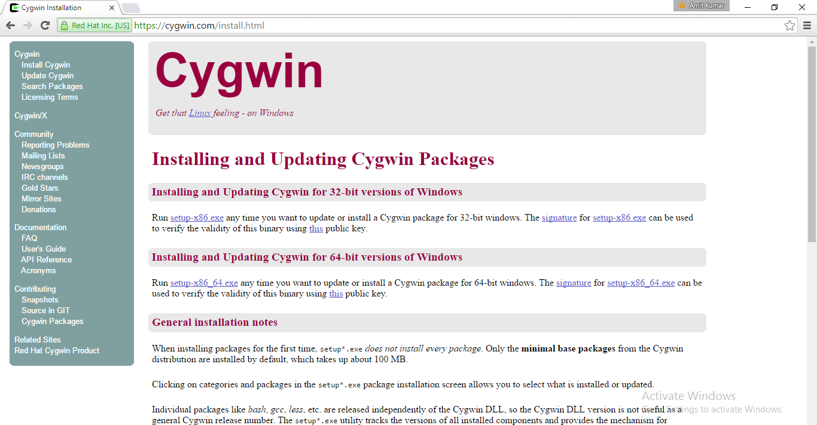
https://cygwin.com/install.html

Slide 7
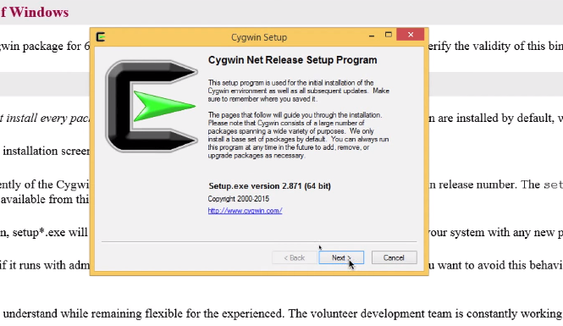

Slide 8
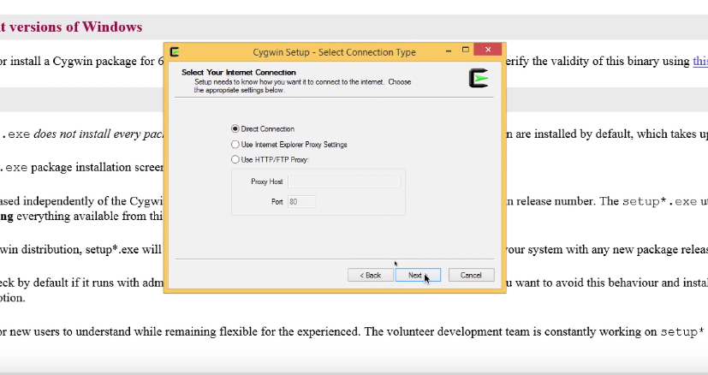

Slide 9
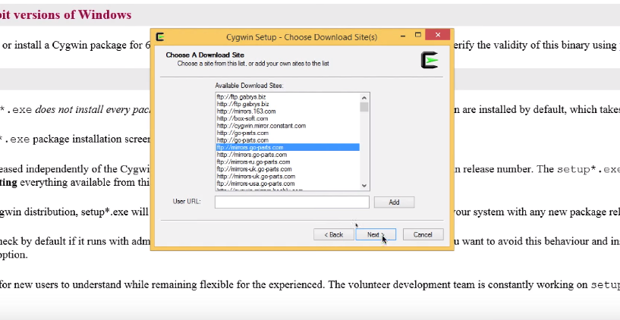

Slide 10
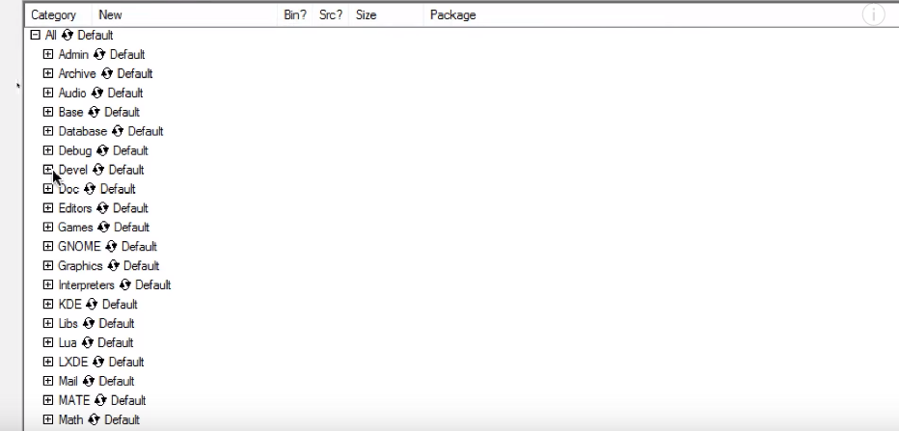

Slide 11
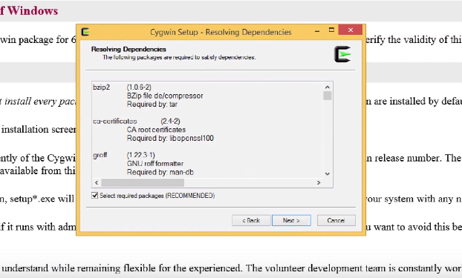

Slide 12
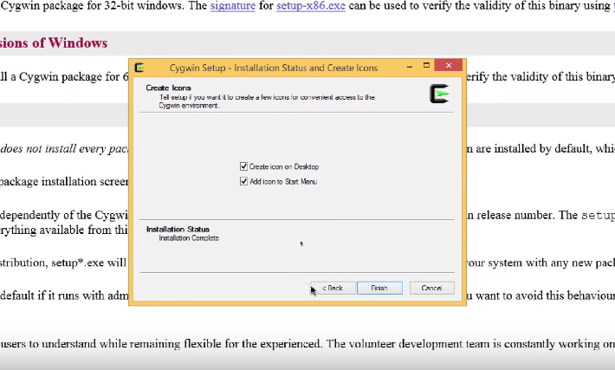

Slide 13
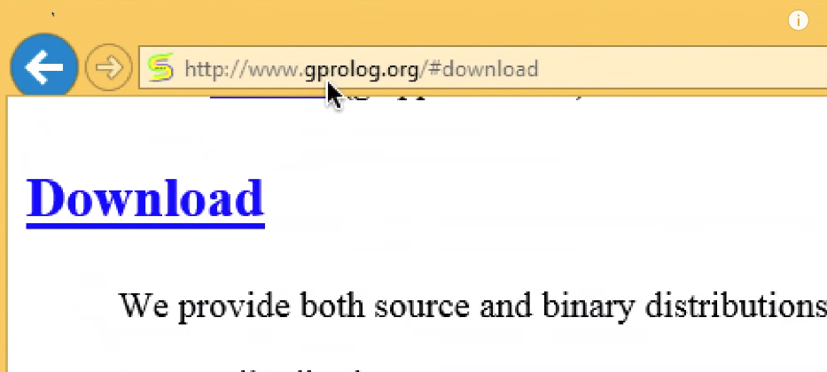

Slide 14
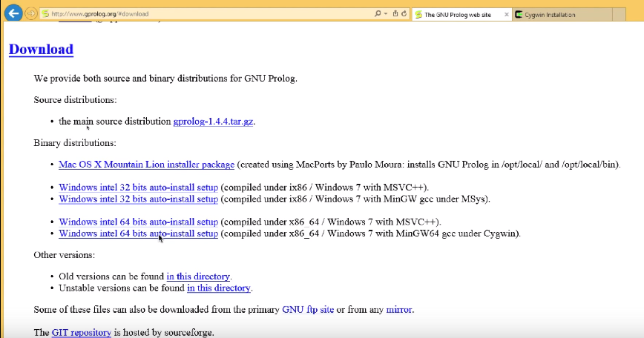

Slide 15
C:\GNU-Prolog\bin
Create a file name ‘db.pl’

Slide 16
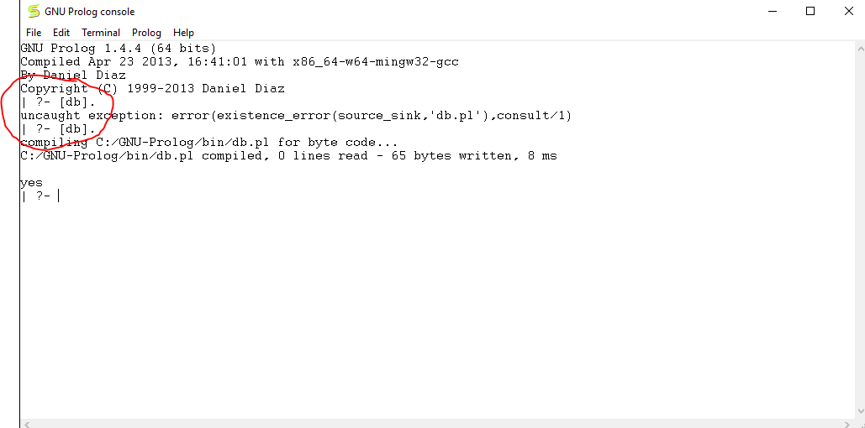

Slide 17
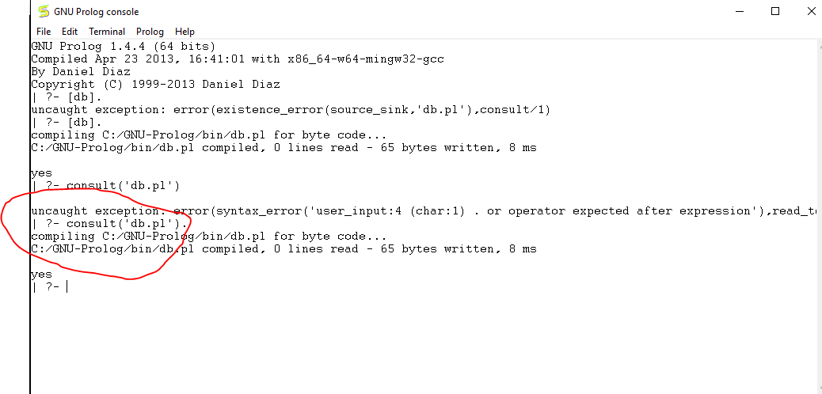

Slide 18
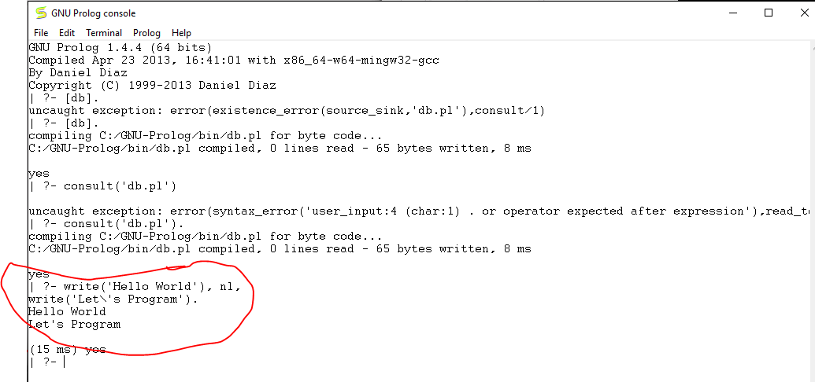
write(‘Hello World’), nl,
write(‘Let\’s Program’).

Slide 19
Exercise: 1

Slide 20
Open ‘db.pl’ file using notepad or notepad++
loves(romeo, juliet).
loves(juliet, romeo) :- loves(romeo, juliet).

Slide 21
Go to GNU Prolog console and load the database:
[db].

Slide 22
Go to GNU Prolog console and run the following command:
loves(juliet, romeo).

Slide 23
Go to GNU Prolog console and run the following command:
loves(romeo, X).

Slide 24
Exercise: 2

Slide 25
Open ‘db.pl’ file using notepad or notepad++
male(albert).
male(bob).
male(bill).
male(carl).
male(charlie).
male(dan).
male(edward).
female(alice).
female(betsy).
female(diana).

Slide 26
Go to GNU Prolog console and run the following command:
[db].
female(alice).
listing(male).
listing(female).

Slide 27
Go to GNU Prolog console and run the following command:
For finding combination of male and female
male(X), female (Y).
For seeing next combination use ; (semicolon sign)

Slide 28
Exercise: 3

Slide 29
Open ‘db.pl’ file using notepad or notepad++
happy(albert).
happy(alice).
happy(bob).
happy(bill).
with_albert(alice).
runs(albert) :- happy(albert).
dances(alice) :-
happy(alice),
with_albert(alice).

Slide 30
Go to GNU Prolog console and run the following command:
[db].
runs(albert).
dances(alice).

Slide 31
Exercise: 4

Slide 32
Open ‘db.pl’ file using notepad or notepad++
does_alice_dance :- dances(alice),
write('When Alice is happy and with Albert she dances').

Slide 33
Go to GNU Prolog console and run the following command:
[db].
does_alice_dance.

Slide 34
Exercise: 5

Slide 35
Open ‘db.pl’ file using notepad or notepad++
swims(bob) :-
happy(bob),
near_water(bob).

Slide 36
Go to GNU Prolog console and run the following command:
[db].
swims(bob).
You will get an error :P

Slide 37
We can’t use ‘AND’ without defining any rule.
Undefined rule need to be separated.

Slide 38
Thank You

